Slide 1
Journey PPT
Aditya Vikram Singh

Slide 2
Data and Databases
ER Diagram
Normalization
Denormalization
Case study on ER Diagram
Dimension Modelling
SCD

Slide 3
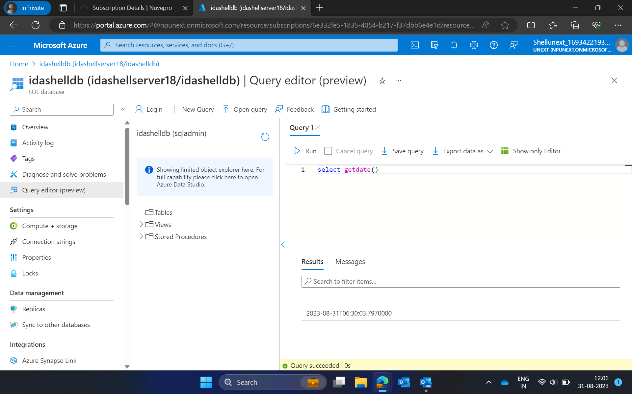

Slide 4
Overview of Big Data
4V’s of Big Data
Volume
Variety
Velocity
Veracity
Batch Processing
Stream Processing
Big data frameworks - spark, Hadoop
Data Warehouse
Data Lake
Cloud Computing Basics
Operational and Capital Expenditure
Azure Fundamentals

Slide 5
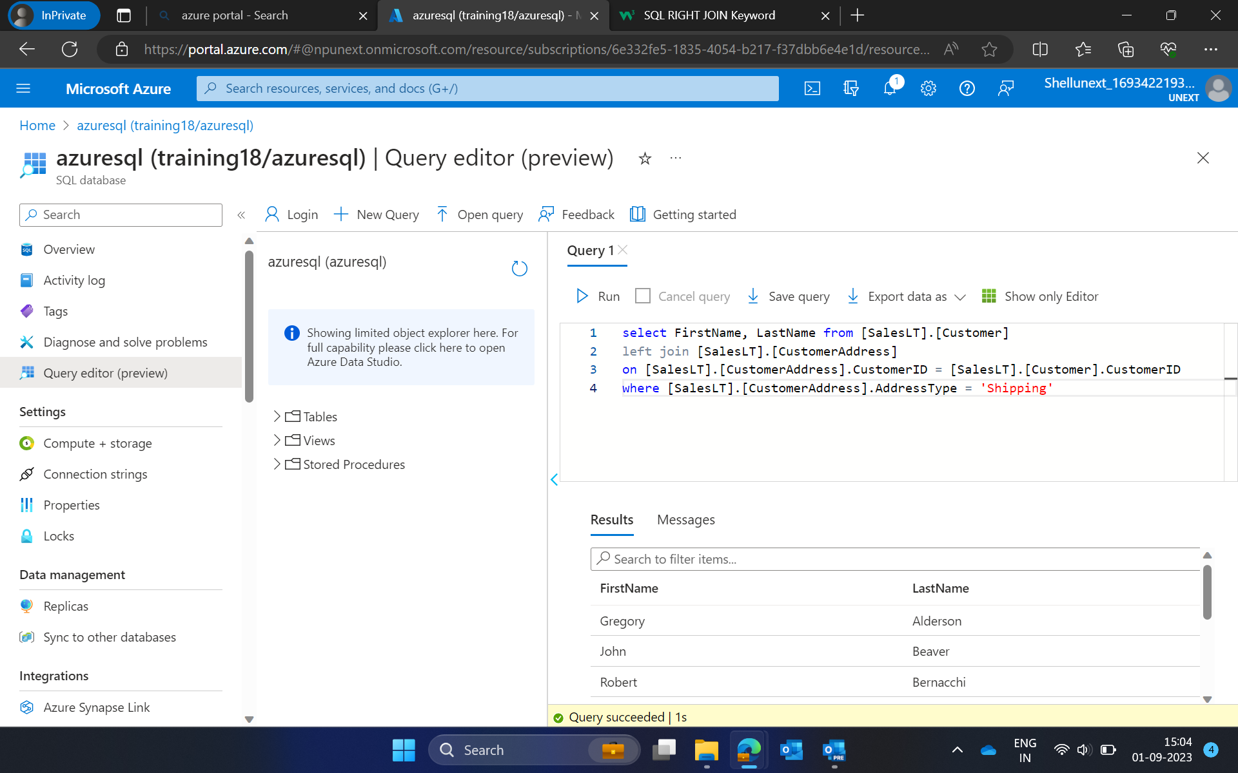

Slide 6
Azure SQL
Types of resources
Single DB, Elastic DB
Configuring azure SQL database and server
getDate()
Views and schemas
Drop, truncate and delete commands
Altering tables
Key constraints

Slide 7
